Slide 1
Chada Tech
Scrum-Agile approach
By: Chase Knoblock

Slide 2

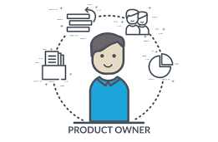
The Agile Roles – Product Owner
Oversees the project – owns the product being created
Decides what is created and who creates it
Ensures product is highest quality for users and business by:
Setting goals/timeline
Maintaining product backlog/keeping priorities in order
Collecting feedback

Slide 3

The agile Roles – Scrum Master
Ensures the development team runs efficiently
Coaches or guides the development team by:
Make sure all members are on the same page
Assist with backlog management
Create/Lead scrum events
Puts the team first and advocates for its members

Slide 4
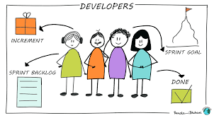
The Agile roles - Developers
Develope a plan for the sprint
Completes the sprint
Attend and participate in scrum activities
Report progress and complications
Work/Communicate with development team
Provide ideas for User Stories

Slide 5
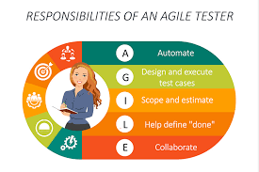
The agile roles - Tester
Understand acceptance criteria
Set boundaries, ensure exception handling and failures
Work with team on design to better performance and accessibility
Build and test the product

Slide 6

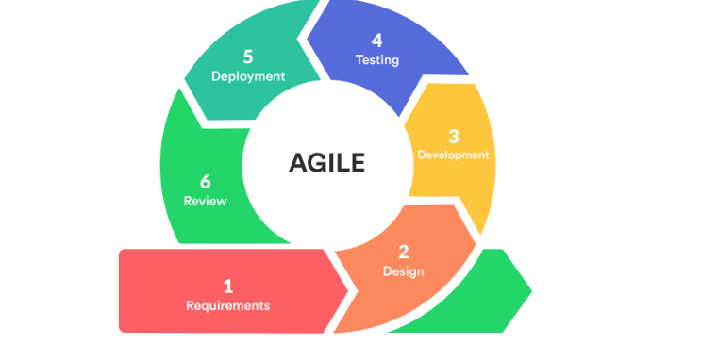
Software Development Life Cycle in Agile
Requirements
Collaborate with stakeholders and users
Gather requirements/set expectations
Design
Create detailed process for development/functionality
Determine timeframe/set budget
Development
Begin development – break up functionality into small parts
Testing
Occurs at same time as development
Identify and mitigate bugs
Deployment
Complete testing and release product
Maintenance
Implement new features and fix bugs that arise

Slide 7
Waterfall Model
Requirements
Set requirements and expectations of product
Design
Create very detailed plan for development
Development
Begin development on product
Testing
Testing occurs after development has finished
Product tested as a whole
Deployment
Release the product
Maintenance
Fix arising bugs and check to see if it continues to meet requirements
Waterfall Model would have made our development more difficult
The design would have to be very detailed
Testing does not occur until after development is done, making it harder to find bugs and is inefficient
When changes occur, Waterfall Model is not flexible and changes are not easily added to development, if added at all before the end

Slide 8
Agile vs. Waterfall
Agile
Flexible
Team-driven
Communication based
Easy to make changes
Testing occurs while developing
I believe is the better option, considering the work done on the SNHU Travel site
Waterfall
Linear
Requires a lot of planning
Very difficult to make changes and find bugs as testing occurs at the end of development
Would have made development more difficult with SNHU Travel site as important changes were required in the middle of development

Slide 9
Sources
Cobb, C. (2021, January 5). Agile Project Management training. Agile Project Management. https://managedagile.com/what-does-it-mean-to-be-an-agile- developer/
Obergfell, Y. (2024, January 10). Scrum team and roles in Agile Project Management. International Scrum InstituteTM. https://www.scrum- institute.org/Scrum_Roles_The_Scrum_Team.php
The Scrum Team Roles and Accountability. The Scrum Team | Scrum Alliance. (n.d.). https://resources.scrumalliance.org/Article/scrum-team
The 2020 scrum GUIDETM. Scrum Guide | Scrum Guides. (n.d.). https://scrumguides.org/scrum-guide.html

